Slide 1

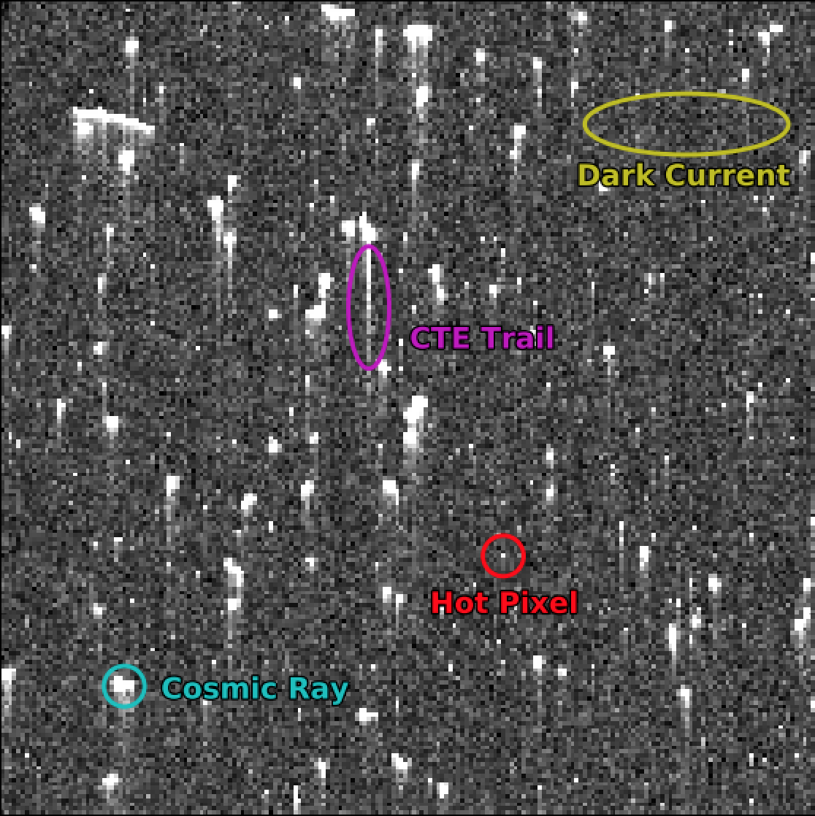
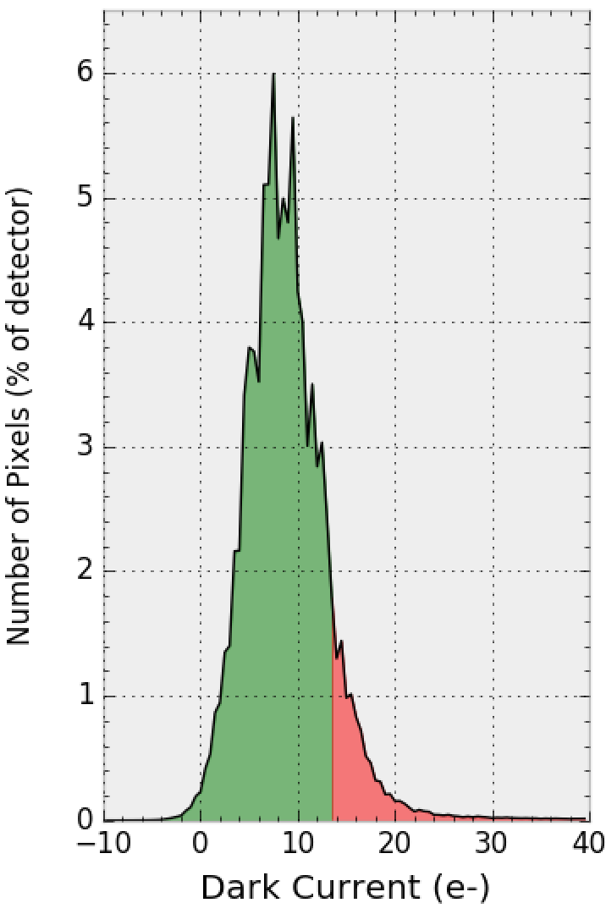
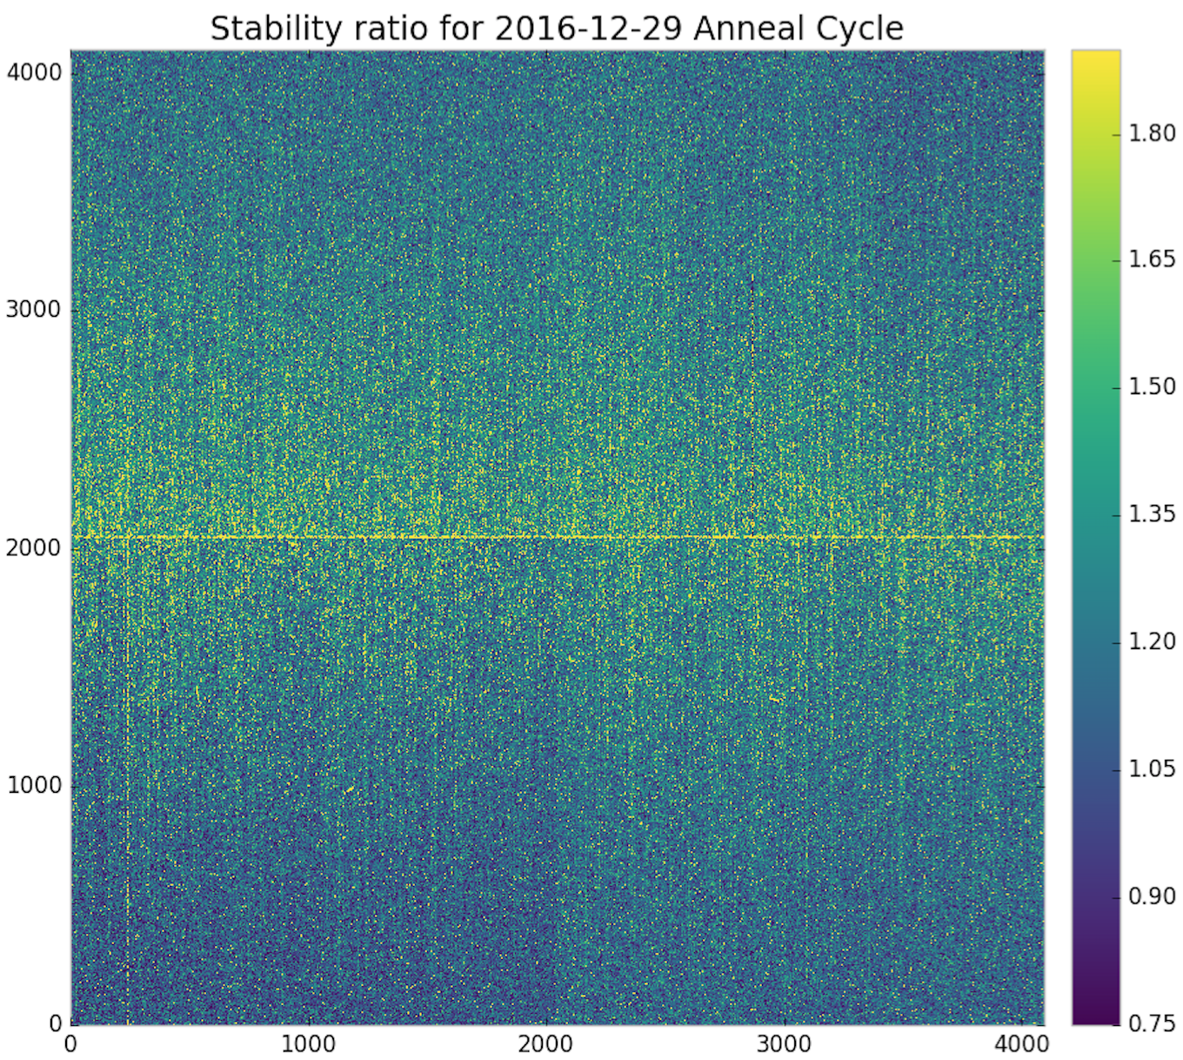
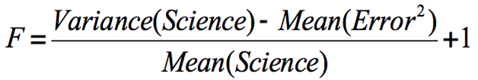
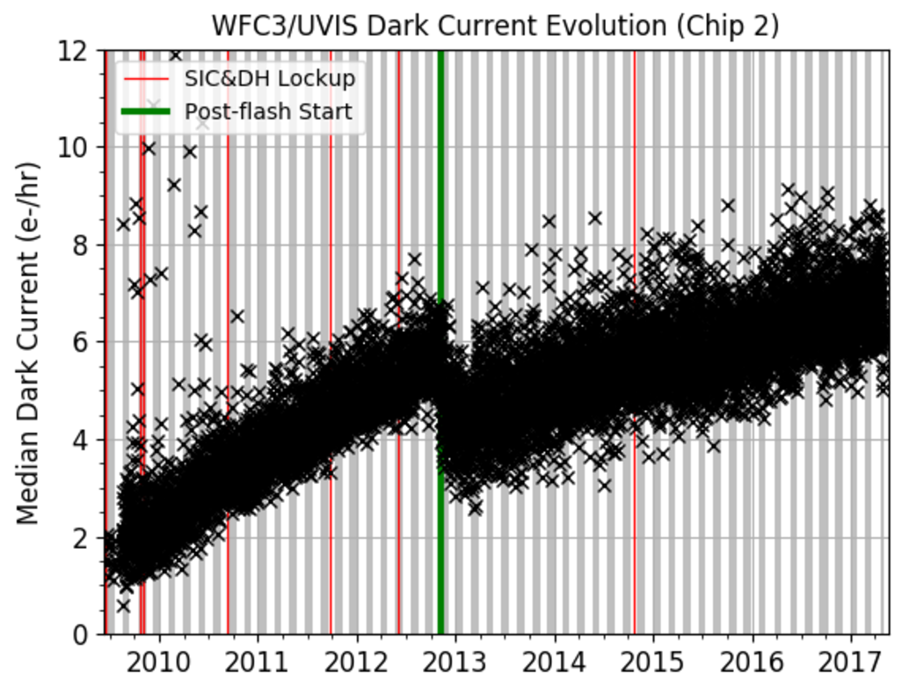
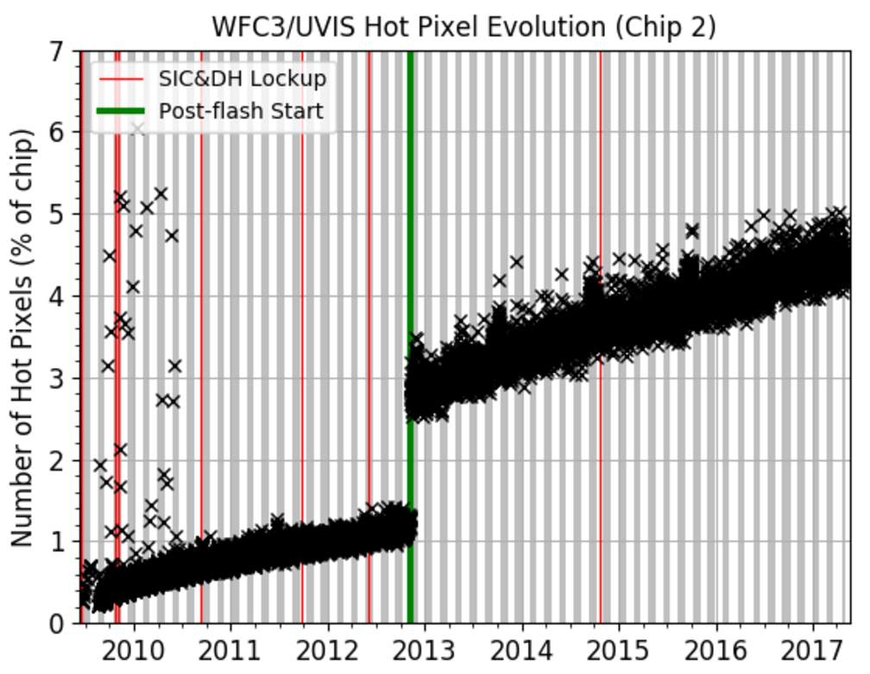
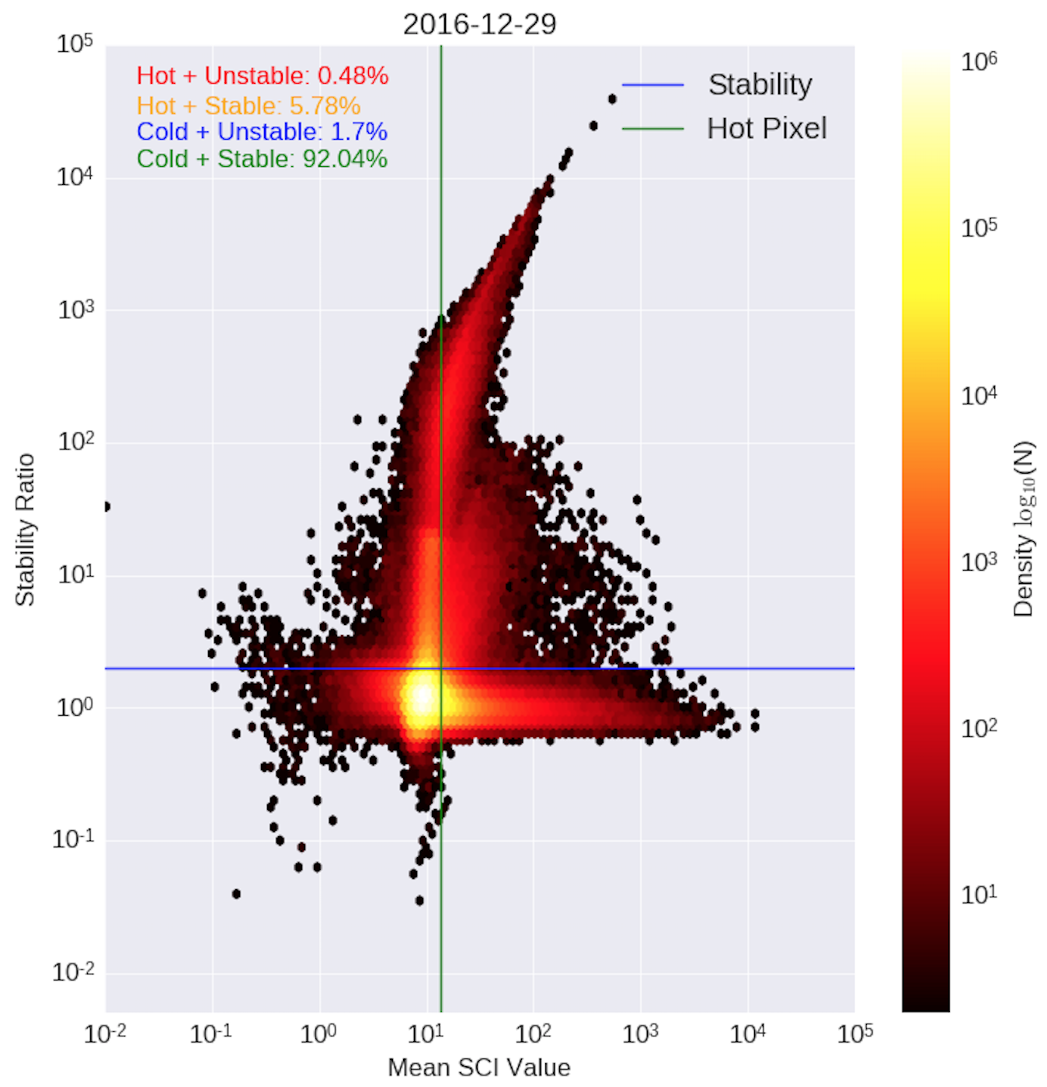
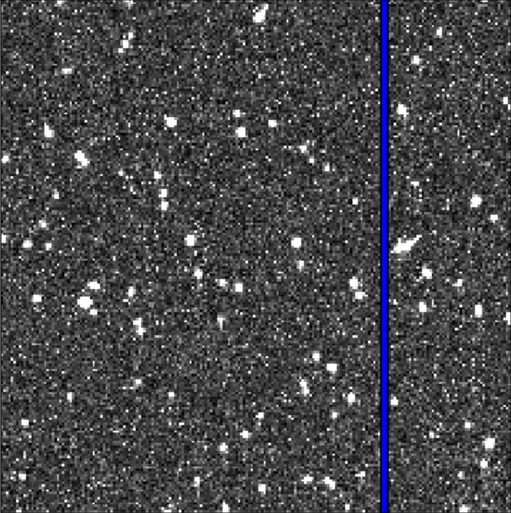
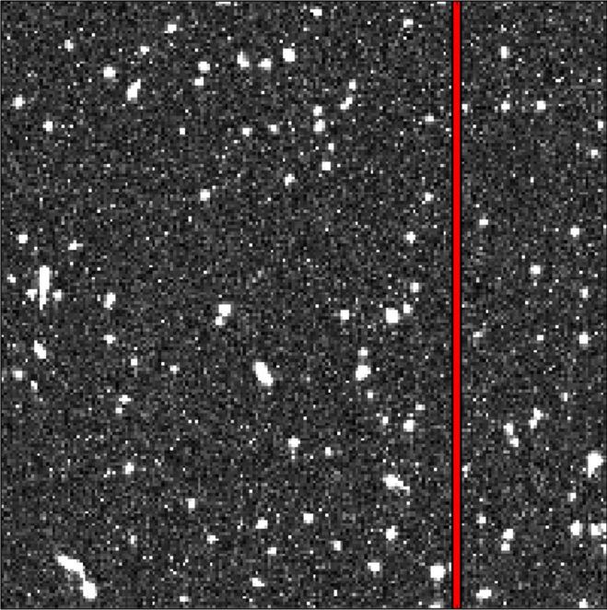
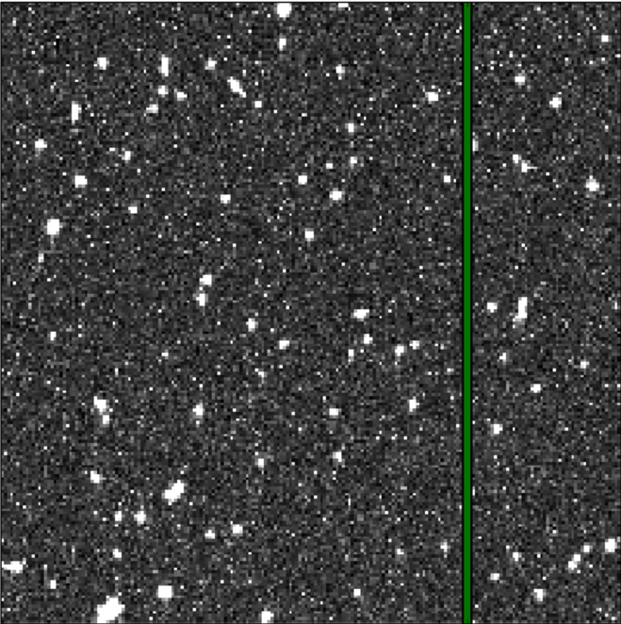
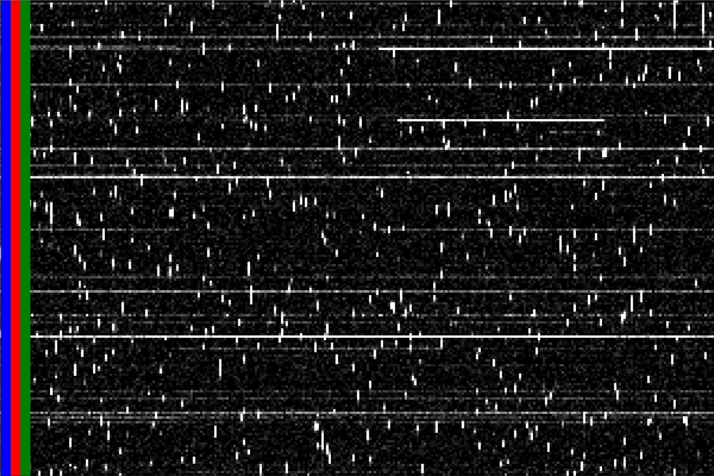
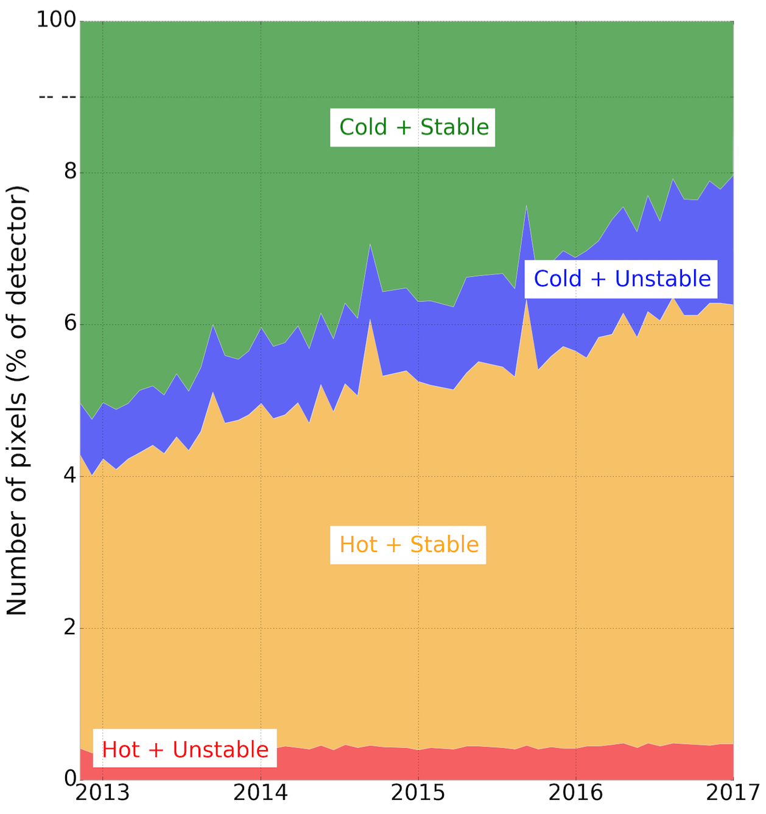
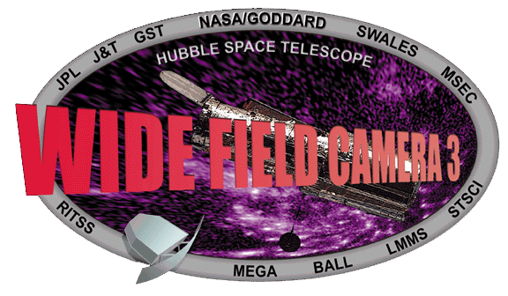


Using Dark Images to Characterize the Stability of Pixels in the WFC3/UVIS Detector
Matthew Bourque, Sylvia Baggett, David Borncamp, Norman Grogin, and the WFC3 Team (STScI)
Abstract
The Ultraviolet-Visible (UVIS) detector on board the Hubble Space Telescope's (HST) Wide Field Camera 3 (WFC3) instrument has been acquiring 'dark' images on a daily basis since its installation in 2009. These dark images are 900 second exposures with the shutter closed to measure the inherent dark current of the detector. Using these dark exposures, we have constructed ‘pixel history' images in which a specific column of the detector is extracted from each dark and placed into a new time-ordered array. We discuss how the pixel history images are used to characterize the stability of each pixel over time, as well as current trends in the WFC3/UVIS dark current.
1. UVIS Dark Observations
4. Pixel Stability
(Left) A 200x200 pixel region taken from a 900-second UVIS dark, showing the nominal features of background dark current, cosmic rays, hot pixels, and CTE trails.
(Right) The distribution of pixel values in a typical 900-second UVIS dark. The pixels with values exceeding the hot pixel threshold of 54 e-/hr (13.5 e- in 900 sec) are shaded in red. Bin size is 0.5 e-.
For each pixel, we calculate its stability (F) over each anneal cycle using the following equation:
F<1: No variance above noise (stable)
F=1: Variance matches noise (stable)
F>1: Some variance above noise (stable)
F>=2: considered “unstable”
Note that typically there are ~100 dark observations within an anneal cycle, and only non-cosmic ray-affected pixels contribute to the stability measurement.
(Left) The stability measurement for each pixel for the December 2016 anneal cycle.
2. Hot Pixels and Dark Current
We aim to classify each pixel into one of four categories:
Cold + Stable: mean(SCI) < 54 e-/hr, F < 2
Cold + Unstable: mean(SCI) < 54 e-/hr, F > 2
Hot + Stable: mean(SCI) > 54 e-/hr, F < 2
Hot + Unstable: mean(SCI) > 54 e-/hr, F > 2
(Right) The stability versus the mean SCI value in log space for each pixel for the December 2016 anneal cycle. We see that the vast majority of pixels (~98%) are stable. The morphology of this distribution is representative of all anneal cycles since the postflashing of UVIS darks began in November 2012.
The median dark current (left) and number of hot pixels (right) over time for Chip 2 (Amps C & D). Dark current increases roughly 0.5 e-/hr/year and is currently ~7.5 e-/hr. ~1000 new hot pixels above the 54 e-/hr threshold appear every day, currently occupying ~5% of each chip. Each month, the UVIS detector is warmed to +20C (shaded in gray/white regions), erasing 10-20% of the hot pixels.
3. Pixel History Images
(Left) The number of pixels in each classification for each anneal period in the postflash era. Currently, the CALWF3 calibration pipeline only flags hot pixels (i.e. those that exceed the 54 e-/hr threshold) in the Data Quality (DQ) array of images. However, ~3.5-5.5% of these hot pixels could be recovered due to their stability (i.e. hot + stable). Alternatively, there exist ~1-2% of pixels that are not flagged in the DQ array that are not recommended to use due to their instability (i.e. cold + unstable). This analysis is expected to lead to improved DQ masking in future releases of CALWF3.
t=1
t=2
t=3
with h5py.File(‘pixhist.hdf5’) as f:
sci = f[‘{amp}/{col}/sci’].value
err = f[‘{amp}/{col}/err’].value
t
To efficiently perform pixel stability analyses, we constructed ‘pixel history’ images in which we extracted each column from every on-orbit UVIS dark and placed them into a time-ordered array, yielding a single pixel’s ‘history’ along each row of the image. Each column’s pixel history image was placed into a Hierarchal Data Format (HDF) dataset using Python’s h5py library.
References
ACS ISR: “Pixel History for Advanced Camera for Surveys Wide Field Channel,” Borncamp et al., 2017 (in review)
WFC3 ISR 2016-08: “WFC3/UVIS Dark Calibration: Monitoring Results and Improvements to Dark Reference Files,” Bourque & Baggett, 2016, available at http://www.stsci.edu/hst/wfc3/documents/ISRs/WFC3-2016-08.pdf
This poster and supporting materials available at https://github.com/bourque/AAS-2017-Austin
Questions? Email bourque@stsci.edu or help@stsci.edu
Poster 117.11

